Slide 1
Ranson Thomas
RN, BSN

Slide 2
Growing Up
I was born in Gainesville Fl. on Halloween in 1984
My father was an agriculture teacher and my mother was an insurance agent. I have a younger brother who is 6 years younger than me who is in college right now
When I was 3 we moved to Inverness Fl.
In 2000 my family and I moved back to Gainesville and I have been here ever since

Slide 3
Education
In 2003 I went to Santa Fe College in Gainesville hoping to major in history when I transferred to a university
In 2007 instead, I graduated from Santa Fe’s nursing program with my ASN
In 2008 I enrolled in the RN-BSN program at UCF and graduated in 2010.

Slide 4
Work
In 2007 I began working as a floor nurse on a med/surg floor at Shands Hospital at UF
In 2010 after receiving my BSN I began working as an adjunct professor in the nursing department at Santa Fe College
In 2011 I left Shands to focus on my job at Santa Fe and my masters work here at UCF

Slide 5
Right Now
I am still an adjunct at Santa Fe where I primarily teach lab, lecture and clinicals in the CNA courses.
I am enrolled at UCF working on my MSN in education
Currently living in Gainesville with my girlfriend of 4 years who is also a grad student at UCF in the history department

Slide 6
Long walks on the beach, etc.
In my spare time I run and practice Western Boxing. I used to be a Judo player but had to stop due to back problems.
In 2008 I was an intern on the Obama campaign for president, in 2009 I worked on the No On Alachua County Charter Amendment 1 campaign, and from 2009-2011 I volunteered for Obama For America.

Slide 7
Goals
My primary drive for seeking my MSN is to become a better educator and learn the skills I will need to be successful.
In taking this class I hope to better understand how to develop a curriculum as I am not involved much in course planning currently as an educator.
I’m also looking forward to understanding the how nursing curriculum differentiates between what coursework is considered commensurate with an ASN, BSN or MSN and beyond.

Slide 8
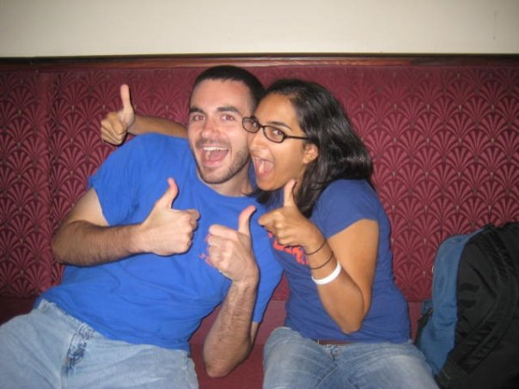
And now so you all have a face to put to a name, here is a picture of my girlfriend and I shortly after we first met. Good luck to all of you this semester, I look forward to learning alongside everyone. These thumbs-up are for you!

